Slide 1
Cef 440: Internet programming(j2ee) and mobile programming
Task 1

Slide 2
Group members
AJAMAH GODLOVE NKEMAJAH | FE21A129
AMABO JOSHUA NGWA | FE21A135
FUKA NEVILLE TENYI | FE21A199
NGOUNG TASSA ALAIN SHIRESS | FE21A262
MBACHAM LOANA NING | FE21A228
NYUYSEVER BORIS DINYUY | FE21A295

Slide 3
1. Major types of mobile apps and their differences
2. Mobile app programming languages
3. Mobile app development frameworks
4. Mobile app architectures and design patterns
CONTENTS
6. How to estimate mobile app development cost?
5. How to collect and analyze user requirements for a mobile app?

Slide 4
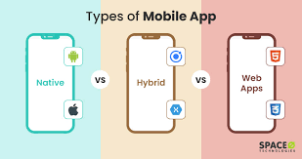
01
Def: A mobile application, commonly referred to as a mobile app, is a software program specifically designed to run on mobile devices such as smartphones, tablets, smartwatches, or other handheld devices
The Major types of mobile apps include;
Native Applications (Native apps)
Progressive Web Applications (PWAs) or Web Apps
Hybrid Application
We will compare their;
Properites
Performance
User experience in the various apps
Access to features
Distribution
Development and cost-platform
Examples of apps

Slide 5
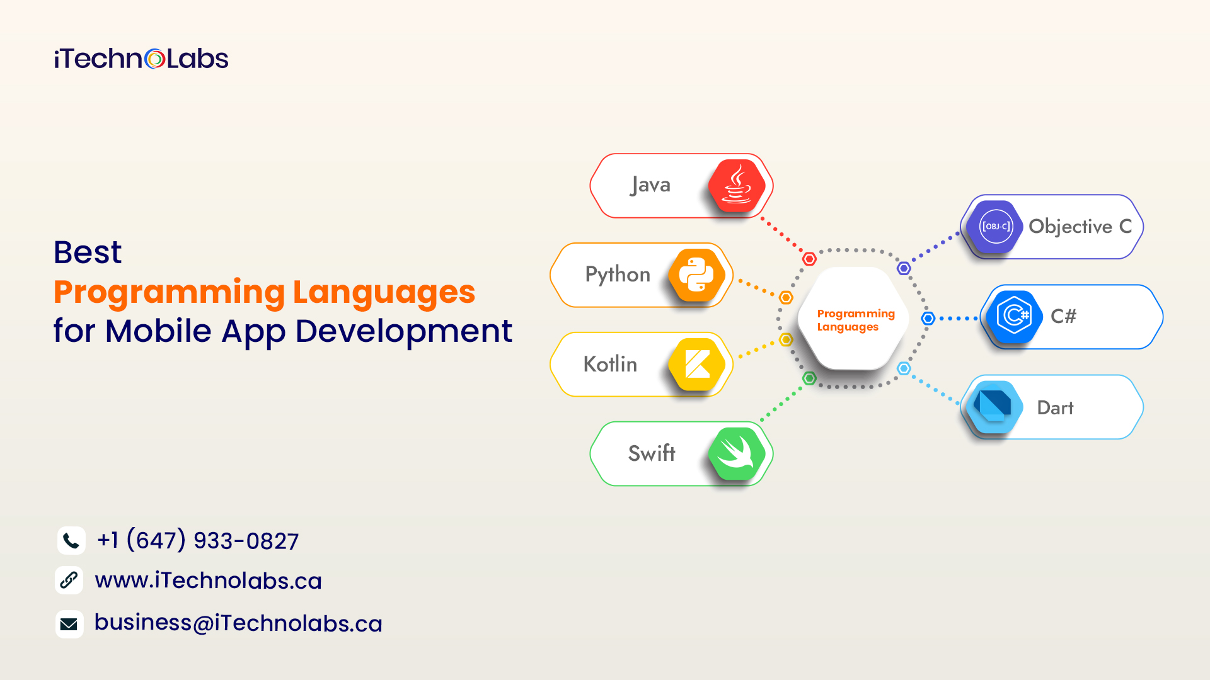
02
-DEF: What is a programming language?
Some of the most popular and best programming languages are;
Java: Cross-platform (Android, Desktop, web)
Kotlin: Cross-platform (Android, Desktop, web)
Swift: iOS, macOS, tvOS, watchOS
Objective-C: iOS, macOS
Javascript: Web

Slide 6
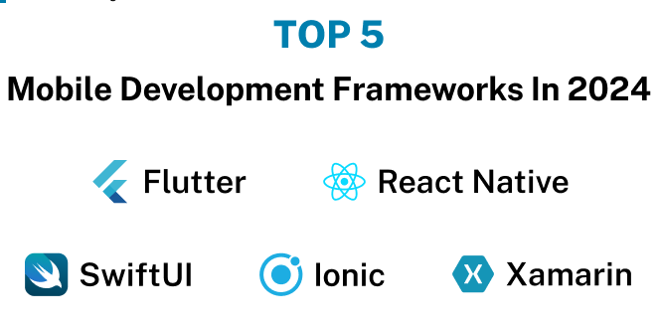
03
-DEF: What is a Software Framework?
Some popular mobile app development frameworks include;
React Native:
Language: JavaScript
Xamarin:
Language: C#
Ionic:
Language: HTML, CSS, JavaScript/TypeScript
Flutter:
Language: Dart
SwiftUI:
Language: Swift

Slide 7
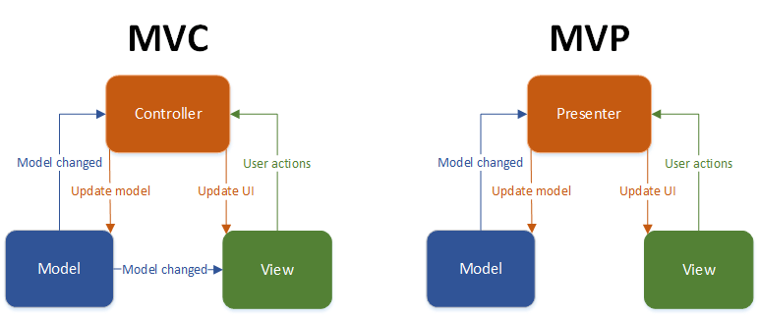
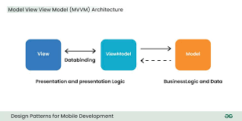
04
-DEF: What are mobile application architectures and design patterns?
Some commonly used mobile application architectures and design patterns are;
Model-View-Control (MVC)
Mobile-View-Presenter (MVP)
Mobile-View-ViewModel (MVVM)
Clean Architecture
Flux/Redux
Dependency Injection (DI)
Singleton……etc

Slide 8
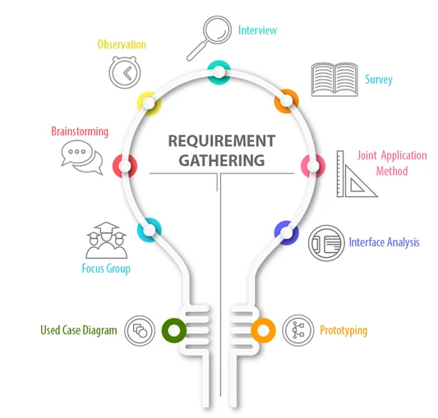
05
-DEF: What is Requirement Engineering?
Some of the stages of collection for Requirement Engineering include;
Identify Stakeholders
Gather User Requirements
Prioritize Requirements
Define Functional and Non-functional Requirements
Validate and Verify Requirements
Document Requirements
Manage Requirements Changes
AIM
Effective requirement engineering ensures that the mobile application aligns with user expectations and business goals.

Slide 9
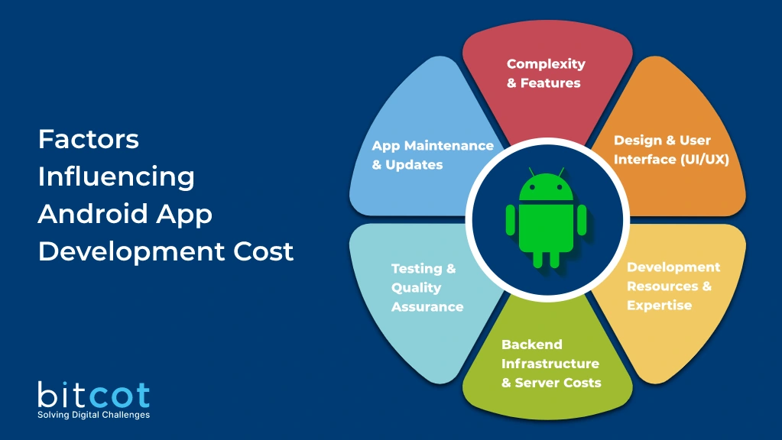
06
-DEF: What the estimation of mobile app development cost refers to?
Some steps in estimating mobile app development cost;
Define Project Scope
Identify Resource Requirements
Break Down Tasks and Effort Estimation
Consider Design and User Experience (UX)
Account for Backend Development
Evaluate Third-Party Integrations
Consider Testing and Quality Assurance
Include Project Management and Communication
Factor in Additional Costs
Research Market Rates
Adjust for Contingencies

Slide 10
THANK YOU FOR YOUR KEEN ATTENTION

